Slide 1
Streamlining Timetable & Student Data Management
Nanyang Technological University
Supervisor: A/P Ling Keck Voon
Presenter: Sean Young Song Jie
Date: 14 May 2025
Notes:
“Good morning. I’m Sean Young, and this is my Final Year Project titled Streamlining Timetable & Student Data Management.
This project automates how timetables are converted from PDFs into digital calendar formats.”

Slide 2
Agenda
Project Scope
Motivation
Objectives
System Architecture
Work done
Results
Challenges
Conclusion / Q&A

Slide 3



Original/Ideal Project Scope
Timetable Extraction
(PDF → ICS)
Module Instructor Assignment Extraction
(HTML → CSV)
Student List Processing
(Excel → CSV)

Slide 4
Prioritise the Project Scope
Why I Focused on Timetable (PDF → ICS) | Why I Deferred Other Modules
PDF layout is complex to parse | HTML: simple table scraping
Timetable format is unique to NTU | Just used for staff reference
Strongest learning value | Excel → CSV is easier
Output is .ics (directly usable) | Student lists already exist via Blackboard
Notes:
“I decided to prioritize the timetable PDF to ICS component first, because it seemed like the most complex part of the entire project. Although the timetable is visually structured, the way it's encoded in the PDF is very unstructured — and the NTU-specific format adds to the complexity. I also felt it offered the best opportunity for learning and practical application.
The HTML file, on the other hand, is essentially just a table, so extracting it would mostly be a straightforward web-scraping task. It was mainly meant to show which professor teaches which class.
For the student list, similar data already exists through NTU Blackboard. And since Excel is easier to parse than PDF, converting to CSV would be less technically demanding.
So I made a clear decision to focus on the timetable system. If time allowed later, I would explore the other modules — but that wasn’t feasible within this project’s timeline.”

Slide 5
Motivation
Staff receive PDFs only
Manual re-entry into calendars
Updates mean repeating the process
Time-consuming and error-prone
Notes:
At NTU, teaching staff receive their timetables as PDFs.
These can’t be imported into calendar platforms.
Instead, staff must manually retype every entry — and if the schedule changes, the entire process starts over.
It’s frustrating, inefficient, and error-prone.

Slide 6
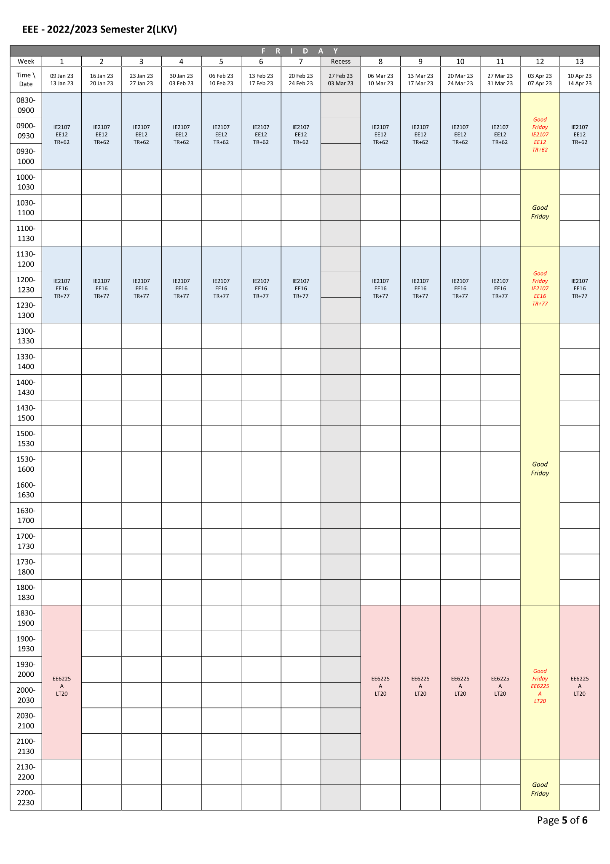
Timetable Parsing Challenges
Fig 1. Cropped NTU Sample Timetable
Notes:
This is a sample from a real NTU timetable.
Although it looks structured to us, it's not actually machine-readable.
Each course is spread over multiple lines, and special events like holidays are inserted just like regular classes.
The layout also shifts slightly between semesters.
So, it’s not a simple table-extraction task — we need to rebuild structure visually.

Slide 7




Objectives
Detect layout
OCR text
Edit courses
Export .ics
Notes:
My project had four main goals:
Detect the layout of the timetable using a model, extract the course details via OCR, allow users to review and edit data, and finally export a usable .ics calendar file.

Slide 8
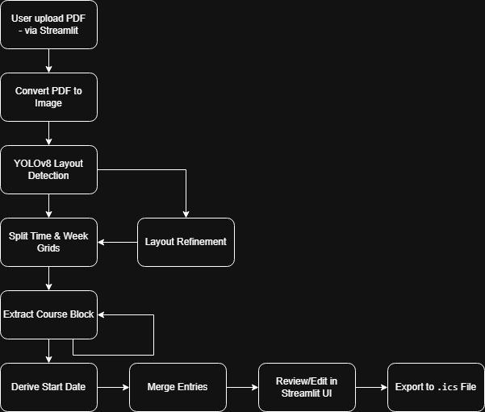
System Architecture
Fig 2. System Architecture
Notes:
Here’s the full system architecture.
The PDF is converted to an image, YOLO detects layout regions, OCR extracts text, and clustering groups stacked lines.
Parsed entries are mapped onto a grid, structured as JSON, and edited through a web UI before exporting to .ics

Slide 9
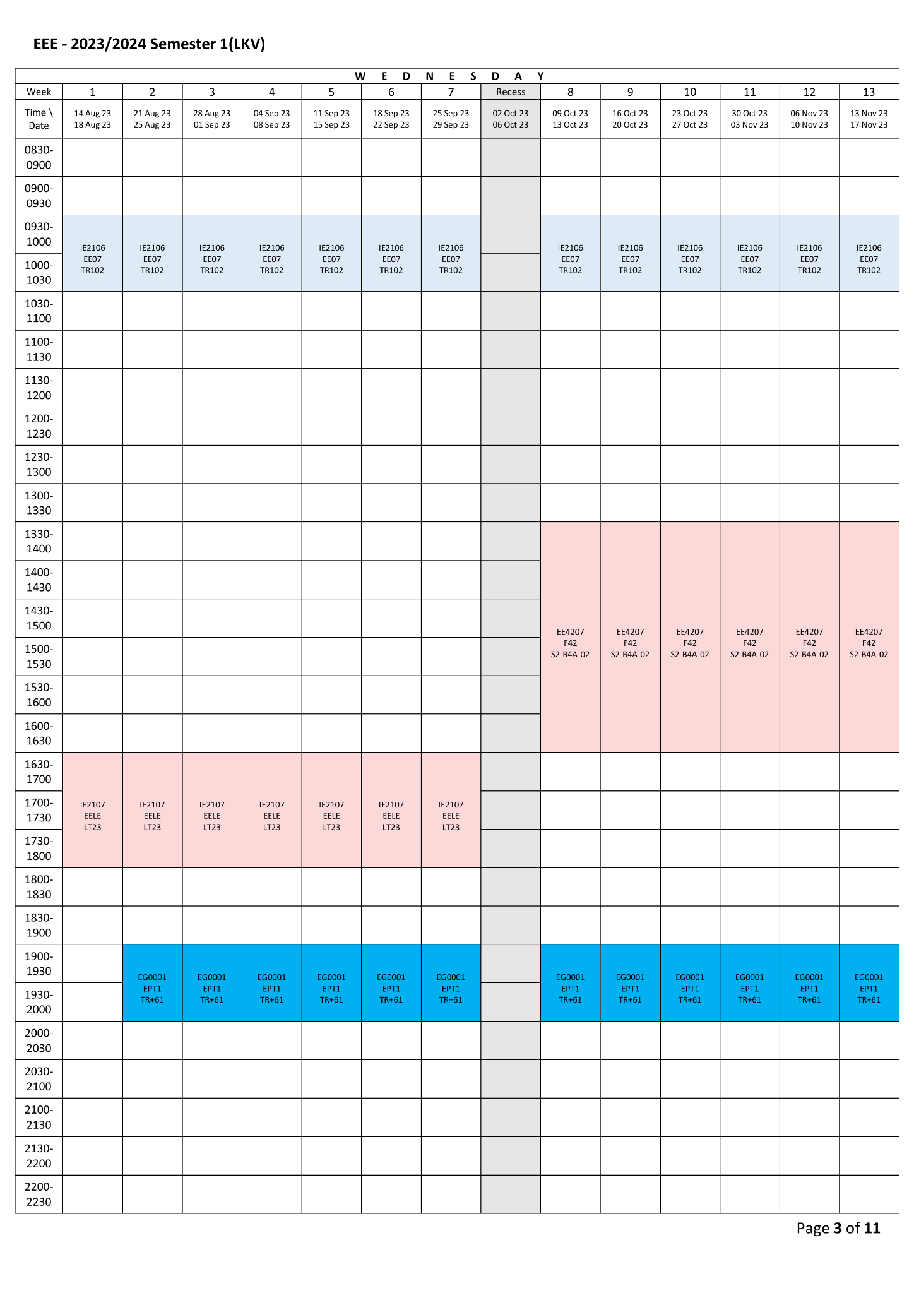
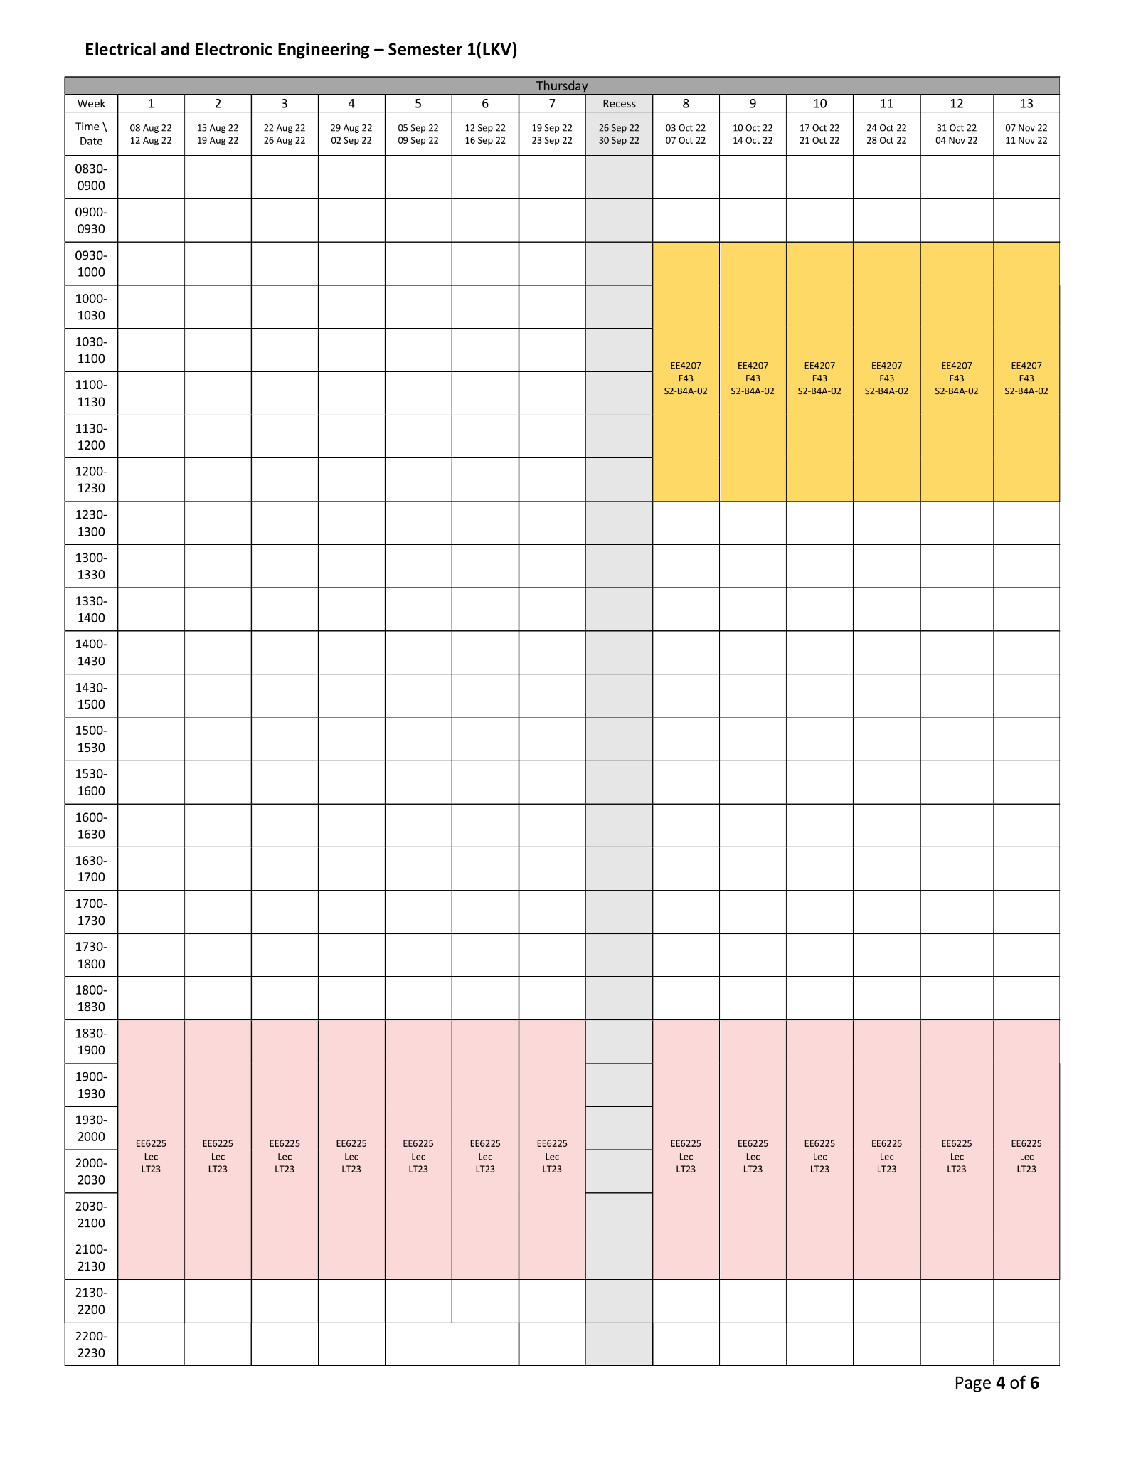
Layout Detection
Any
Difference?
Fig 3. Comparison of NTU Sample Timetables
Notes:
I trained a YOLOv8 model to detect three key elements: the time slot column, the week headers, and the course cells.
This lets the system understand where each course appears — even when layouts vary slightly between semesters.

Slide 10
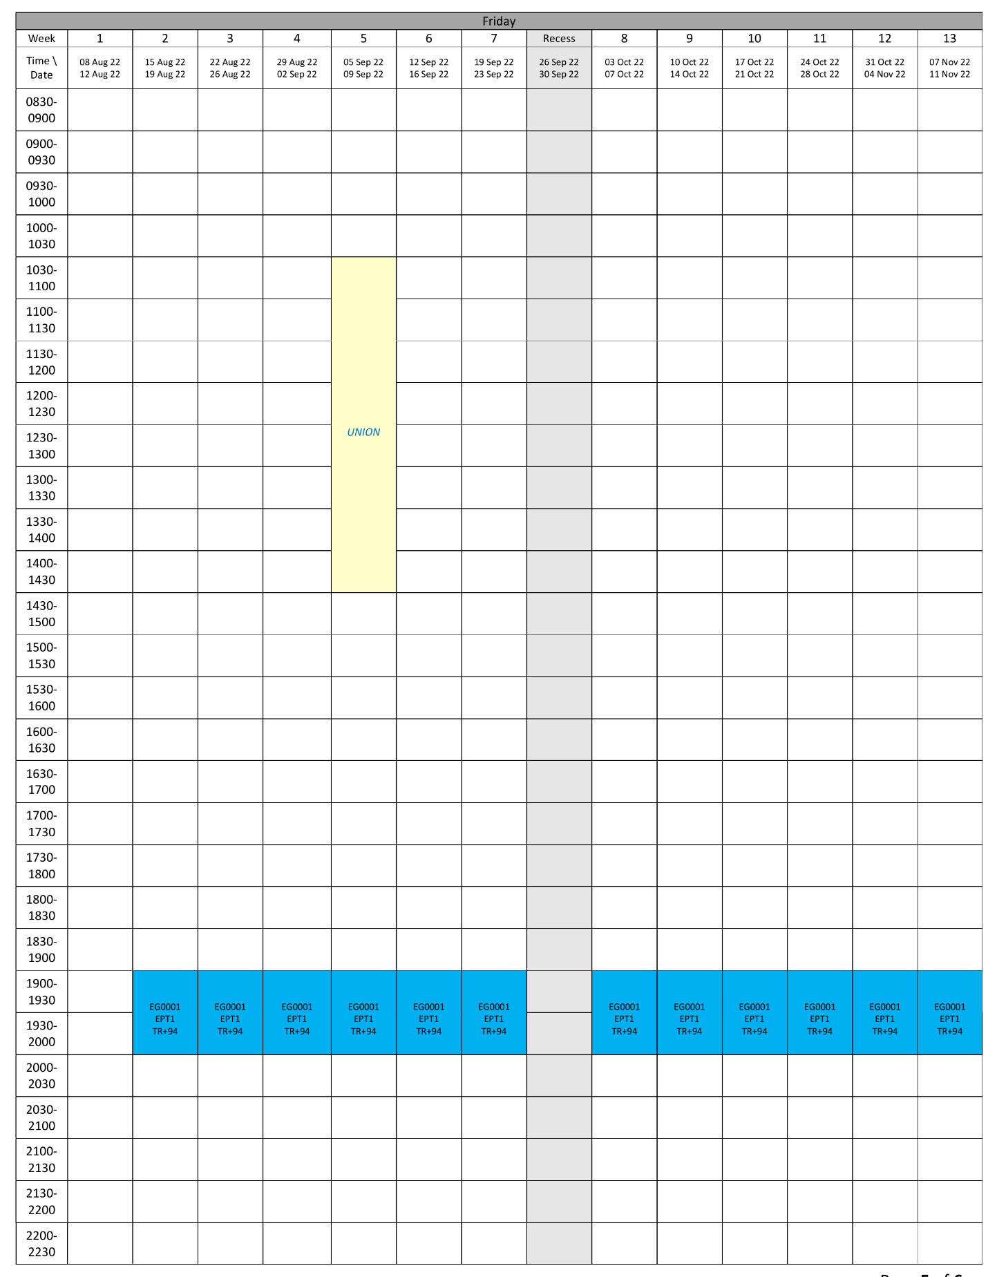
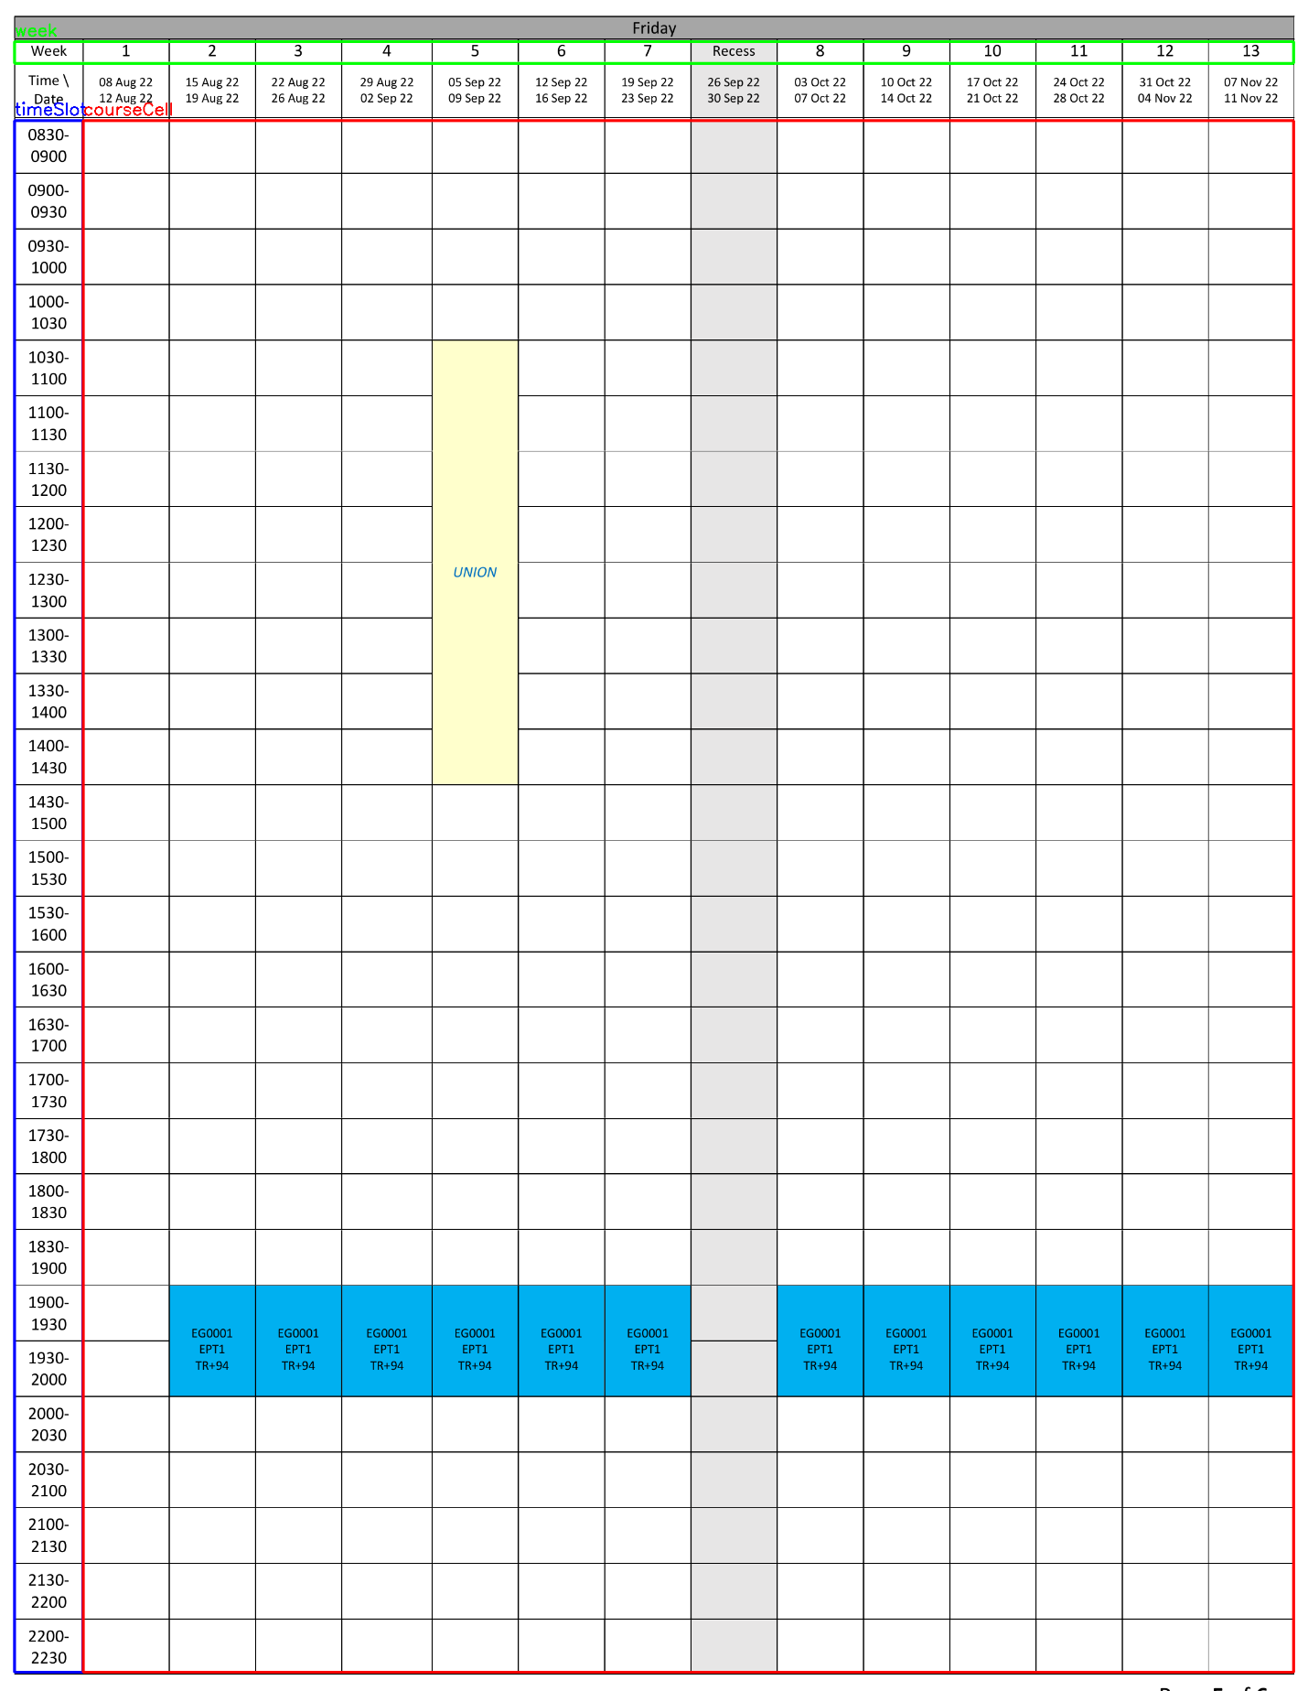
Layout Detection (YOLOv8)
Fig 4. NTU Sample Timetable with bounding boxes
Notes:
I trained a YOLOv8 model to detect three key elements: the time slot column, the week headers, and the course cells.
This lets the system understand where each course appears — even when layouts vary slightly between semesters.

Slide 11
OCR and Clustering
Unrestricted OCR Output | Clustering Output
Multiple repeated lines: Deepavali EG1001 (x13) TR+91 (x13) PT05 (x13) | One tight group: EG1001 TR+91 PT05
❌ Mixed content from multiple weeks ❌ Holiday mixed in | ✔️ Tight grouping ✔️ Isolate single course entry ✔️ DBSCAN + week bounding box
Notes:
While the visual line order is consistent across the timetable, the real issue isn’t disorder — it’s overflow.
Without clustering, OCR might pick up repeated text from all 13 weeks or even mix in holiday rows.
Using DBSCAN with coordinate filtering, I isolate the correct vertical block — producing one clean, usable course entry.

Slide 12
Semantic Parsing
JSON sample | Explanation
{ "courseCode": "EG1001", "group": "PT05", "location": "TR+91", "weeks": ["2", "3", "5"], "time": "19:30–21:30", "day": "Monday", "startDate": "08 Aug 22", "note": "Deepavali on Week 11" } | ✔️ Week, day, and time are inferred from cell location ✔️ Holidays detected via fuzzy match ✔️ Notes are stored inside the JSON ✔️ Nothing is skipped automatically — user sees warning and decides in UI
Notes:
After extracting and clustering course blocks, I parse them into structured calendar entries.
This includes matching the block to a week column, time row, and assigning its day and duration.
If a holiday name is detected using fuzzy matching — for example, a noisy OCR result like ‘Depavali’ — it’s flagged and added as a note.
As you can see in this JSON, Week 11 includes a note about Deepavali.
This is not skipped — instead, it informs the user through the interface, allowing them to decide whether to delete or keep it during export.

Slide 13
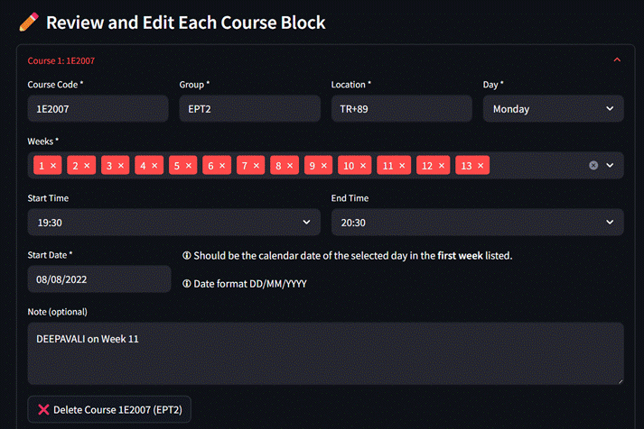
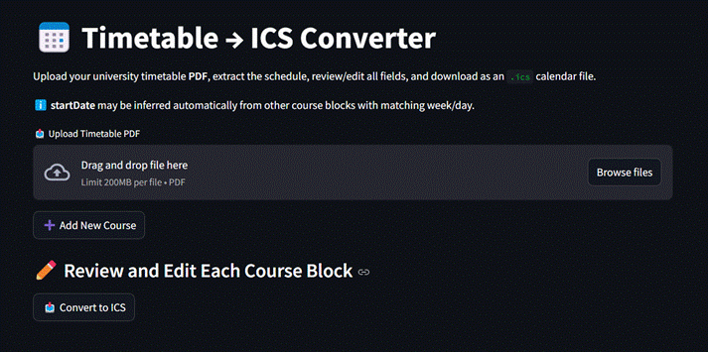
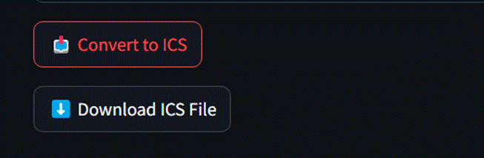
Streamlit UI
Fig 5. Upload NTU timetable PDF and run extraction
Fig 6. Review and fix course blocks: group, venue, weeks, holiday note
Fig 7. Download `.ics` calendar file
Notes:
Here’s how the Streamlit interface works from start to finish.
First, the user uploads their timetable PDF. The system then extracts the layout, text, and clusters the course entries.
Next, they’re shown all detected courses, where they can make changes — fixing OCR mistakes, changing weeks, or removing entries.
Finally, when everything looks right, they can export the full schedule as an .ics calendar file for Google Calendar or other platforms.
This gives the user full control, while automating 80–90% of the process.

Slide 14
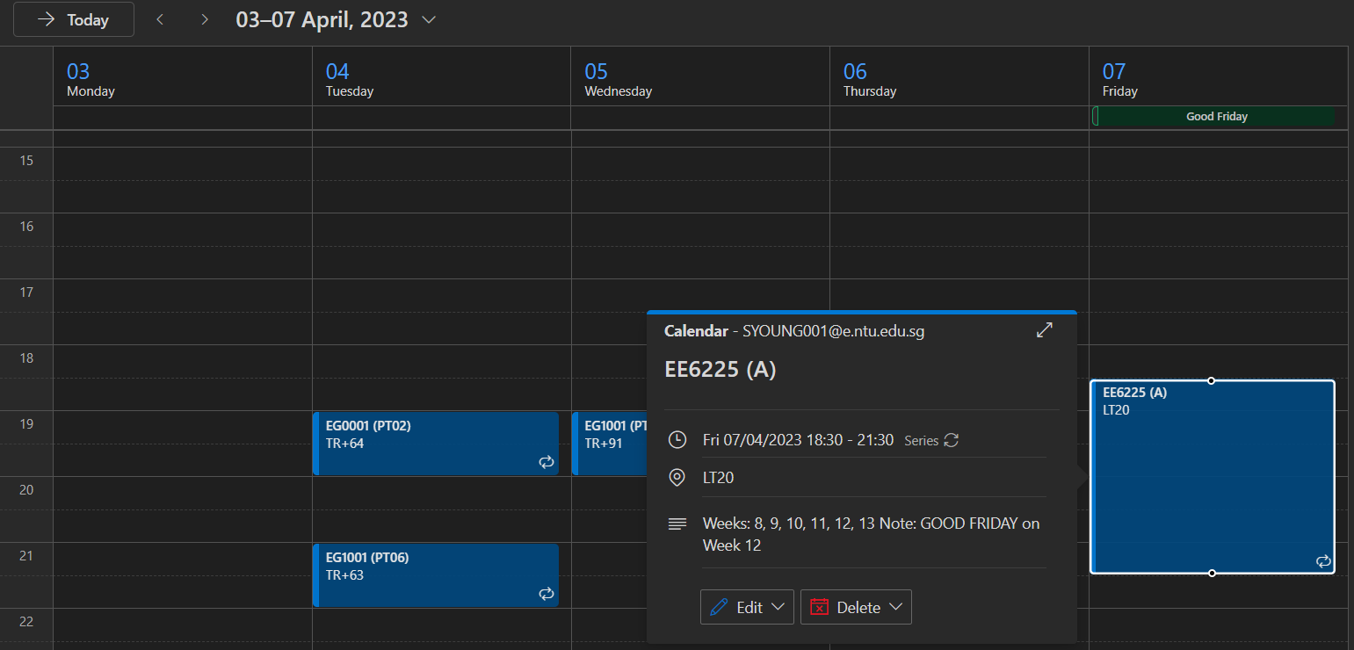
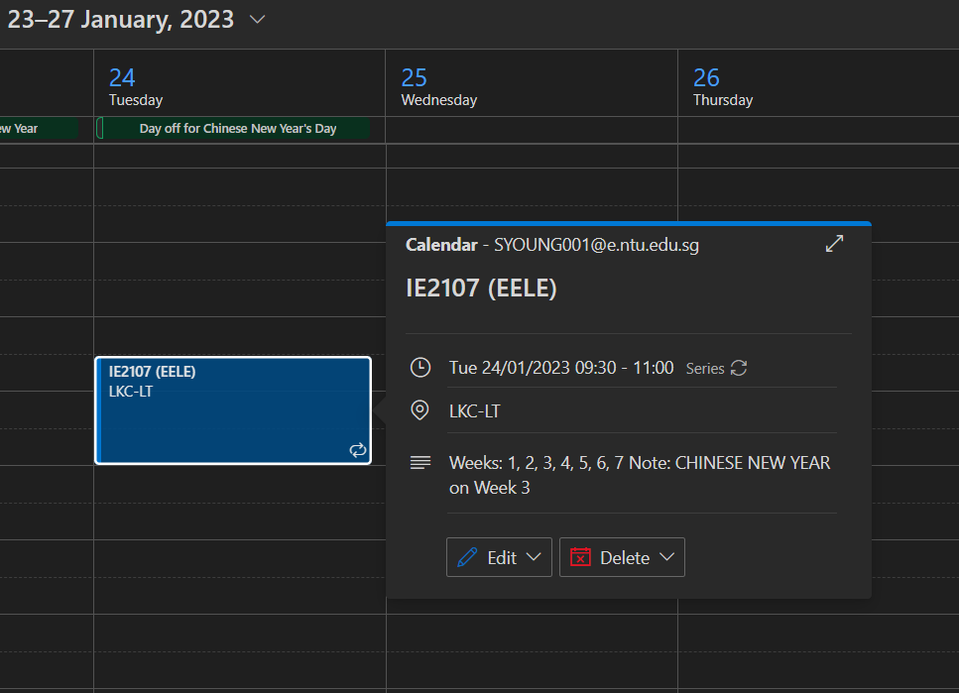
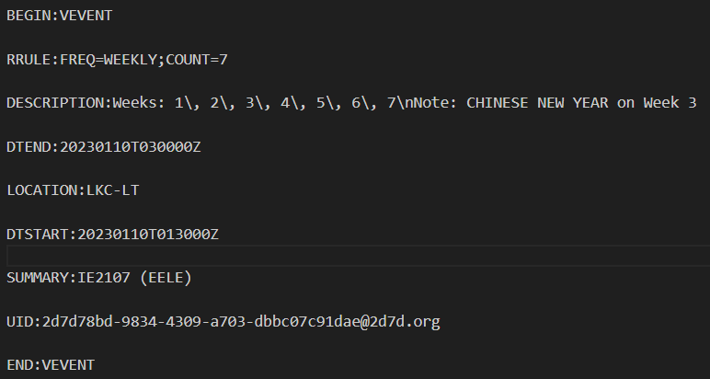
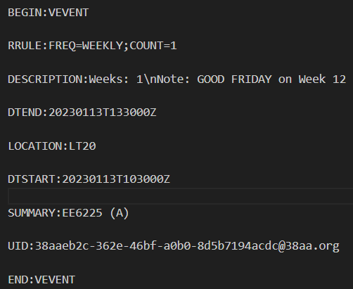
Results
Fig 8. Snippet 1 of imported module
Fig 9. Snippet 2 of imported module
✔️ Successfully imported into Outlook Calendar
✔️ Events match expected time slots
✔️ Output usable by real users
Notes:
This screenshot shows the .ics file from my system successfully imported into Google Calendar.
The events appear on the correct days and times, with the course code, group, and venue in the title.
The system achieves around 80 to 85 percent extraction accuracy on real NTU timetables.
Users can make final edits in the interface, so they’re never locked into raw OCR output.
I’ve also tested these .ics files with other platforms like Outlook — they work seamlessly.

Slide 15
Challenges & Fixes
🔧 Challenge | ✅ Solution
1. OCR misreads (eg., EG1001 → EGI0O1) | Left to the user to verify and fix manually in the UI.
2. Holiday text inflates course block to 4–5 lines | Fuzzy match checks the first 1–2 lines. If a holiday is detected saved to “note” The remaining 3 lines are parsed as a normal course block.
3. OCR reads duplicate content line by line | Used DBSCAN on spatially sliced week bounding boxes to isolate stacked text per week.
Notes:
Some key challenges included OCR noise and inconsistent layouts.
I improved text accuracy using preprocessing and DBSCAN.
Holiday rows were hard to detect, but fuzzy string matching solved that.
Layout shifts were handled using bounding boxes instead of fixed templates.

Slide 16
Challenges & Fixes
🔧 Challenge | ✅ Solution
4. Layout spacing varies between timetables | Using a custom-trained YOLOv8 model. The model handles variation in size, padding, and spacing.
5. Day and Date bounding boxes removed from training | Removed to reduce noise. Day is inferred from the page index. Date row is extracted in post-processing.
6. Recess Week sorting issue | Recess is retained in weeks and sorted using a custom key (7.5) so it falls logically between Weeks 7 and 8.
Notes:
Some key challenges included OCR noise and inconsistent layouts.
I improved text accuracy using preprocessing and DBSCAN.
Holiday rows were hard to detect, but fuzzy string matching solved that.
Layout shifts were handled using bounding boxes instead of fixed templates.

Slide 17
Challenges & Fixes
🔧 Challenge | ✅ Solution
7. Duplicate course blocks | After parsing, duplicates are merged based on course, group, time, and day. Weeks are combined into a list.
8. Start and End time can’t be accurately derived from visual grid due to center-alignment merged blank cells | The system approximates time using bounding box Y-positions, but UI allows user correction if needed.
9. ICS recurrence rule unsupported by library | Injected a manual RRULE:FREQ=WEEKLY line into the ICS extra field to simulate recurrence.
Notes:
Some key challenges included OCR noise and inconsistent layouts.
I improved text accuracy using preprocessing and DBSCAN.
Holiday rows were hard to detect, but fuzzy string matching solved that.
Layout shifts were handled using bounding boxes instead of fixed templates.

Slide 18
Challenges & Fixes
🔧 Challenge | ✅ Solution
10. ICS assumes entered datetime as UTC when it is SGT | Explicitly format datetimes in SGT, allowing the library to convert to UTC. This lets calendar apps re-interpret time correctly in the user’s timezone when imported.
Notes:
Some key challenges included OCR noise and inconsistent layouts.
I improved text accuracy using preprocessing and DBSCAN.
Holiday rows were hard to detect, but fuzzy string matching solved that.
Layout shifts were handled using bounding boxes instead of fixed templates.

Slide 19
Conclusion & Q&A
✔️ Fully working PDF-to-ICS conversion pipeline
✔️ Layout detection, OCR, and course parsing integrated with Streamlit UI
✔️ Exported calendars compatible with Google and Outlook
What I’ve learnt:
✔️ Not everything must be 100%
✔️ Learn to workaround imperfections
✔️ Training AI model
✔️ Problem Solving and internalising questions
🙋 Questions?
Notes:
To conclude: I built a complete pipeline to convert NTU timetable PDFs into .ics calendar files.
It combines machine learning, OCR, and a user-friendly interface.
The system is already usable — and with more time, it could be extended into a complete all-in-one tool.
Thank you — I’m happy to take your questions.

Slide 20

Thank you

